Slide 1



Supporting Immigrant Students & Families
Training for Educators
[Your Local Union Logo Here]
Updated February 2025
Presenter Name
Local Union
This presentation was adapted from Education Austin’s series of Know Your Rights trainings for educators.
We are grateful to Education Austin and Montserrat Garibay for sharing this important resource and for their continued commitment in supporting immigrant students and families

Slide 2
Overview
What you need to know about supporting immigrant families
How educators can work with allies to ensure colleagues, students, and communities have the information and resources they need
How families and students can create a rapid response plan
Understanding roles of Law Enforcement
The current status of Deferred Action for Childhood Arrivals
Resources, including NEA’s Guidance on Immigration Issues (Jan. 2025)

Slide 3
When we talk about supporting immigrant youth, who are we talking about?

Slide 4
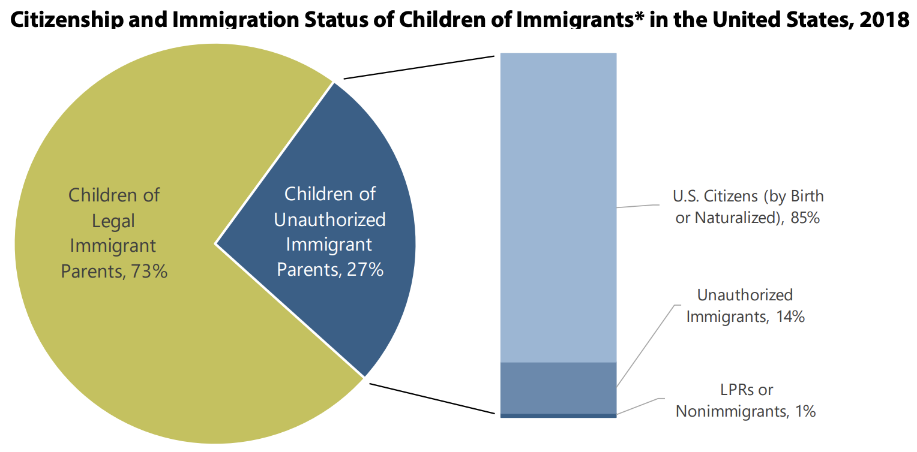
As of 2018, there were approximately 4.4 million U.S.-born children with at least one parent who is undocumented, and 6.8 million who lived with an undocumented family member.
U.S. Citizen Children Impacted by Immigration Enforcement
(American Immigration Council, 2021)

Slide 5

Undocumented students
An undocumented student is an aspiring citizen who came to the U.S. without legal documentation or who has overstayed his or her visa.
They are racially and ethnically diverse, from all over the world and are part of the 11-14 million undocumented immigrants in the U.S.
They often don’t know that they are undocumented until they begin the college application process.
They don’t qualify for federal grants or loans.
May also be known as DREAMERS

Slide 6
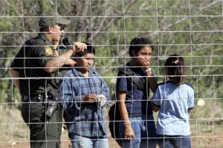
Unaccompanied children
Children who have no lawful immigration status in the U.S.
Are under the age of 18
Have no parent or legal guardian in the U.S. available to provide care and physical custody
Since 2012, more than 600,000 children primarily from Central America, have sought refuge in the U.S., to flee violence in their home countries

Slide 7

Refugee children
A person who is unable or unwilling to return to their home country because of a “well-founded fear of persecution” due to race, membership in a particular social group, political opinion, religion, or national origin.

Slide 8
All children are welcome in our nation’s public schools.

Slide 9
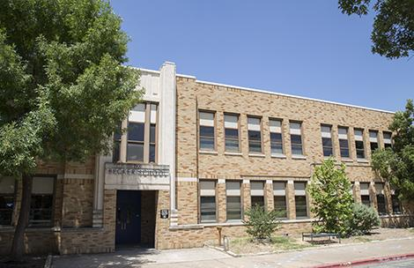
The law has established the common public benefit of our schools serving all children.
Plyler vs. Doe: A Landmark Supreme Court Case
Under federal law, ALL children, regardless of their citizenship or immigration status, are entitled to a K-12 education.
Schools districts that either prohibit or discourage children from enrolling in schools or taking advantage of school services, such as college counseling, because they or their parents are undocumented immigrants may be in violation of federal law.

Slide 10

Public schools are required to follow federal law regarding the privacy of student data
Under the Family Educational Rights and Privacy Act (FERPA), schools are prohibited from providing information from a student’s file to federal immigration agents. The school, however, may release ‘directory’ information, such as a student’s place of birth, and information that is requested under a judicial order or lawfully issued subpoena.
For more on FERPA: Archived Dept. of Ed. Guide for Parents (July 2021)

Slide 11

The Trump Administration rescinded the “sensitive locations” memo that had previously required ICE officers and agents to refrain from enforcement actions on and around school campuses
Sensitive locations previously included:
Schools, colleges, universities and other institutions of learning
Hospitals
Churches, synagogues, mosques and other institutions of worship
Funerals, weddings, and other public religious ceremonies
Public demonstrations, such as marches, rallies or parade
Lawsuits regarding the memo’s rescission are pending.

Slide 12

Schools should be...
Safe Zones
Welcoming places of learning
Free from racism, discrimination and threats of deportation
Responsible for ensuring the safety and well-being of all their students.

Slide 13
What You Can Do
How educators can work with allies to ensure that their colleagues, students, and communites have the information and resources they need.

Slide 14
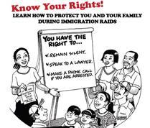
Inform students and their families of their rights
1
Notes:
Distributing materials in schools requires permission from the Administration. Materials distributed in the community in your off-time does not require permission.
Obtain a “know your rights” card:
http://unitedwedream.org/thank-deportation-defense-card-handy-phone/
Link to Know Your Rights flier in multiple languages: http://iamerica.org/know-your-rights

Slide 15

2
Stress the importance of taking proactive steps to ensure the safety and well-being of children in school and at home

Slide 16
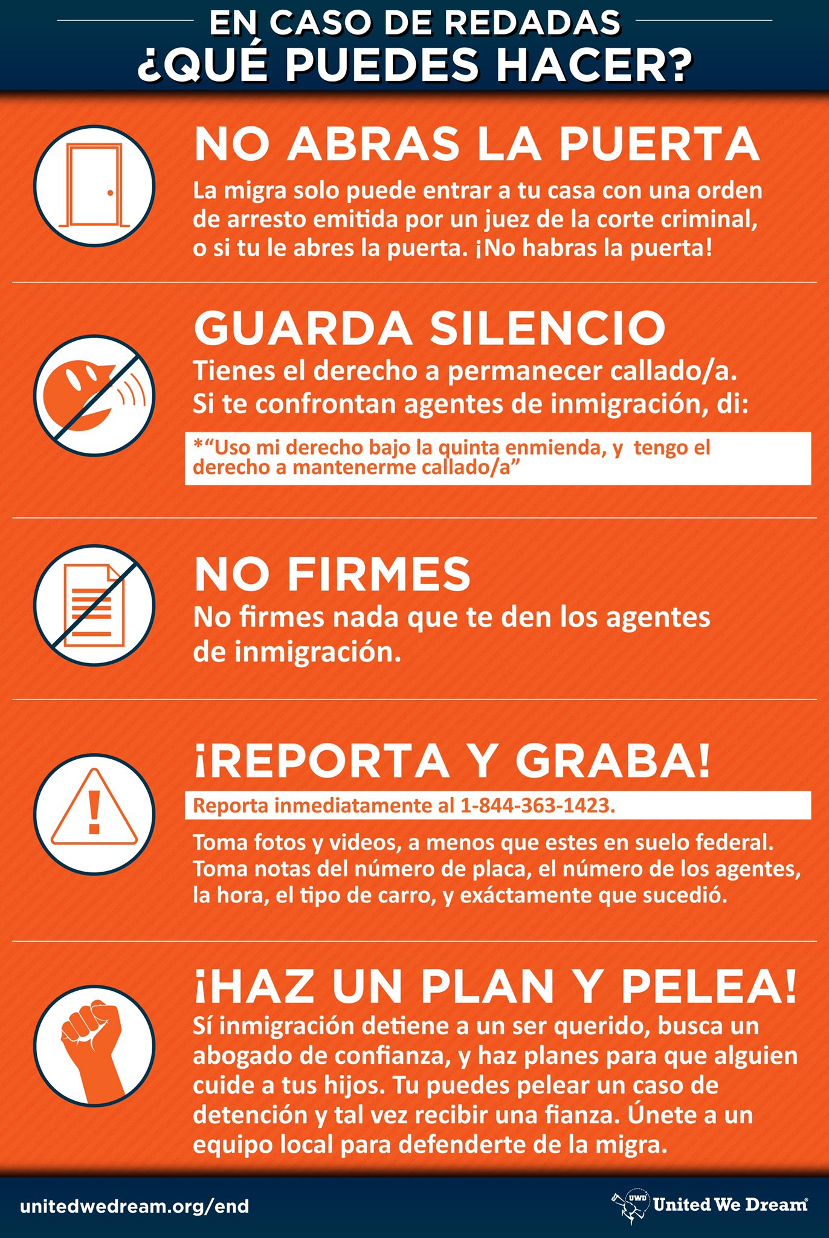
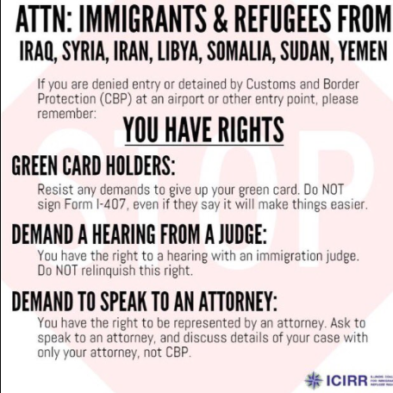
3
Distribute “know your rights” materials to students and families about what to do if a raid occurs or an individual is detained
Notes:
Distributing materials in schools requires permission from the Administration. Materials distributed in the community in your off-time does not require permission.
Obtain a “know your rights” card:
http://unitedwedream.org/thank-deportation-defense-card-handy-phone/
Link to Know Your Rights flier in multiple languages: http://iamerica.org/know-your-rights

Slide 17

4
Remind families to update their emergency contact information frequently.

Slide 18

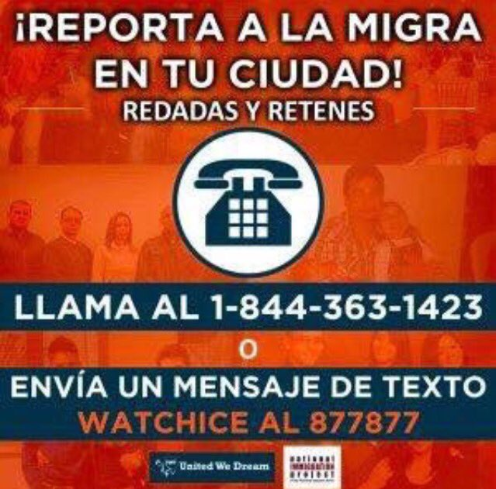
5
Find out if there is a local immigration raid rapid response team in your community
Notes:
These teams usually consists of attorneys, media personnel, and community leaders who may be able to provide support.

Slide 19

6
Hold immigration clinics in your community in partnership with pro bono attorneys, legal aid organizations or immigrant justice groups

Slide 20


7
Provide a safe place for students to wait at school if a parent or sibling has been detained
Notes:
Work with school counselors and school administration to have a plan in case a student’s parents are dertained.

Slide 21

8
Provide school counseling or referrals to students who have had a family member detained

Slide 22
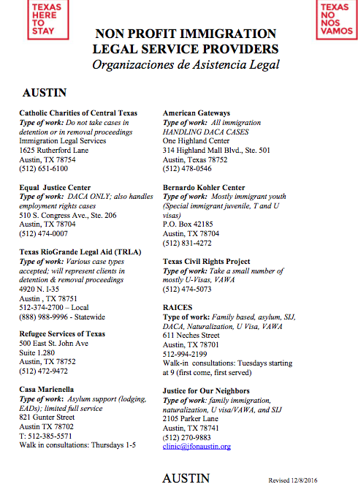
9
Maintain a list of resources, such as social workers, pro-bono lawyers and local immigration advocates

Slide 23
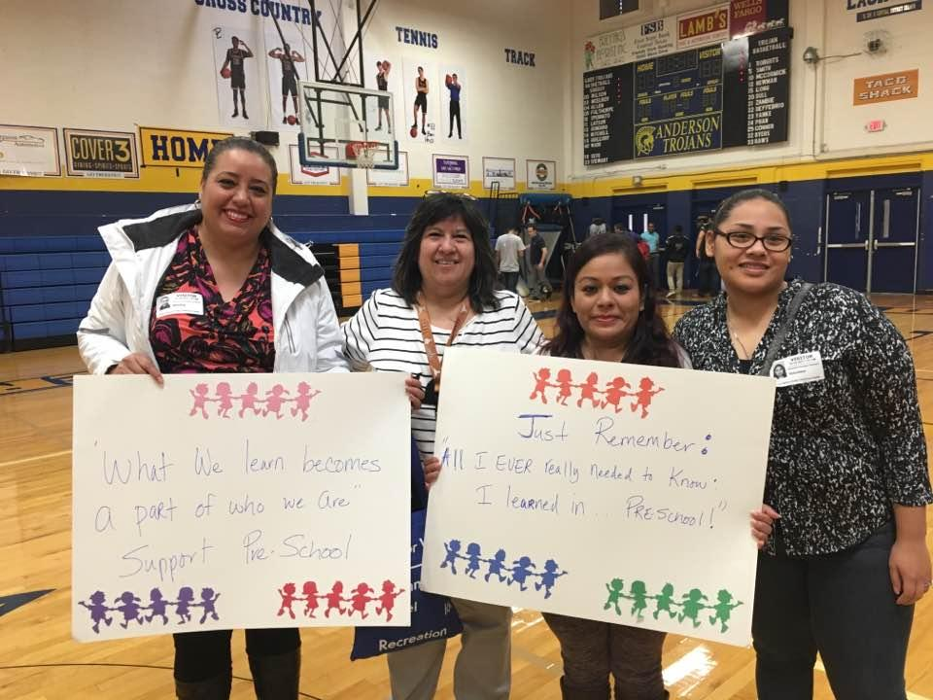
10
Identify someone at your school who can serve as an immigration resources coordinator and advocate
Notes:
This person does things like compile and share resources, including any relevant district policy.

Slide 24
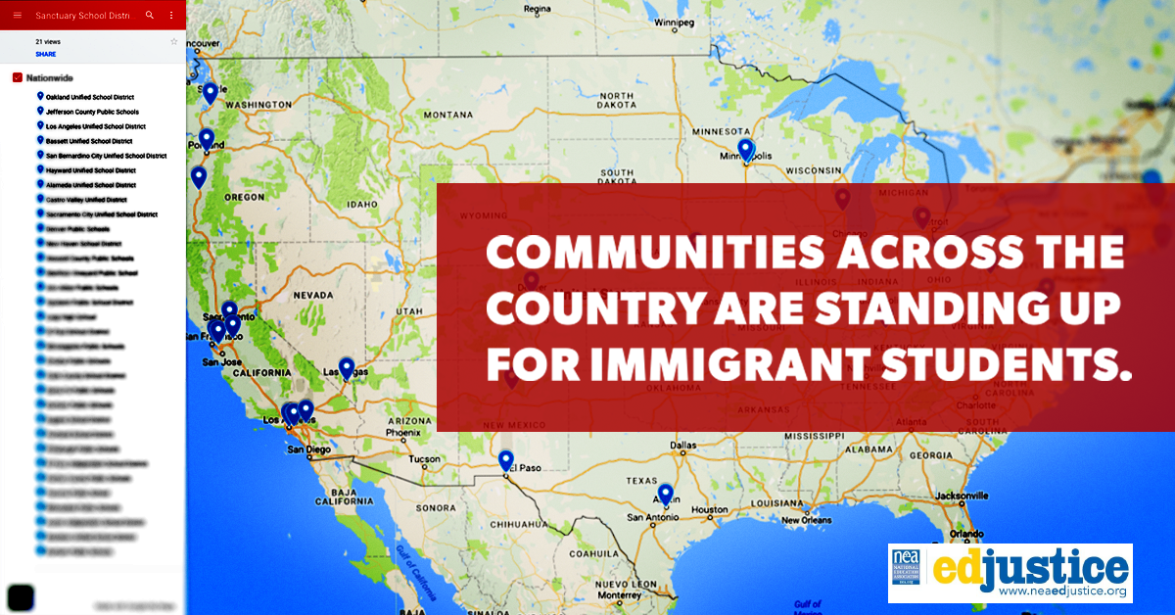
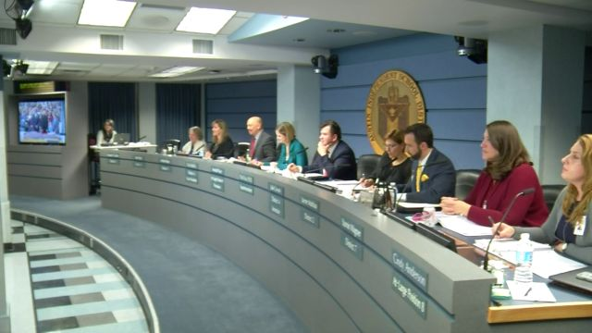
11
Ensure your school is a Safe Zone. Work with your school board to pass a Safe Zone resolution outlining district policy to support your students.
Sample Resolution & FAQ

Slide 25

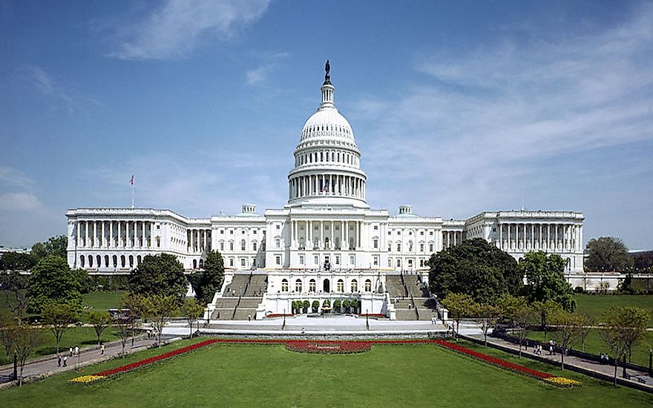
12
Advocate for common sense immigration solutions that reflect our shared humanity. And stand against ICE raids and other policies that don’t result in practical change.
Call your Member of Congress
Write letters to the editor
Work with local community,faith and immigrant rights groups

Slide 26
Being Prepared
How families and students can create a rapid response plan.

Slide 27
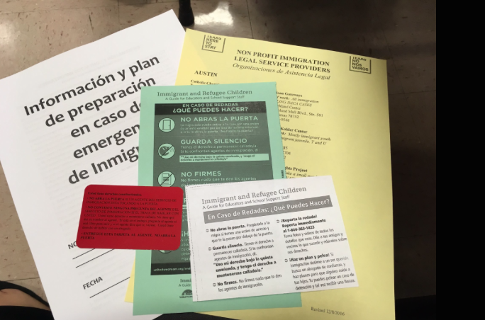
Identify a reputable legal aid organization
Keep the organization’s or person’s contact information with you at all times
Notes:
Like the American Immigration Lawyers Association and Catholic Charities

Slide 28
Tips and Strategies to Avoid Fraud When Finding an Attorney or Legal Advocate
Get a recommendation from a trusted source
Check for credentials and if possible any past disciplinary actions
Identify areas of expertise
Get a written contract
Keep copies

Slide 29
Be Aware: What is notario fraud?
In some countries a “notary public” refers to an individual with training and authorization equivalent to a law license
In the U.S. a notary public is authorized only to witness the signature of forms
Only lawyers and BIA-accredited representatives (who work for certain non-profit agencies) can give legal advice
Immigrants should never pay a “notario”, travel agent, or tax preparer to advise them on immigration matters or to help fill out immigration forms

Slide 30

Identify at least two willing caregivers
Write down their complete contact information
Ask children to memorize caregivers’ contact information
Update school emergency contact forms frequently and designate approved adults for student pick up

Slide 31
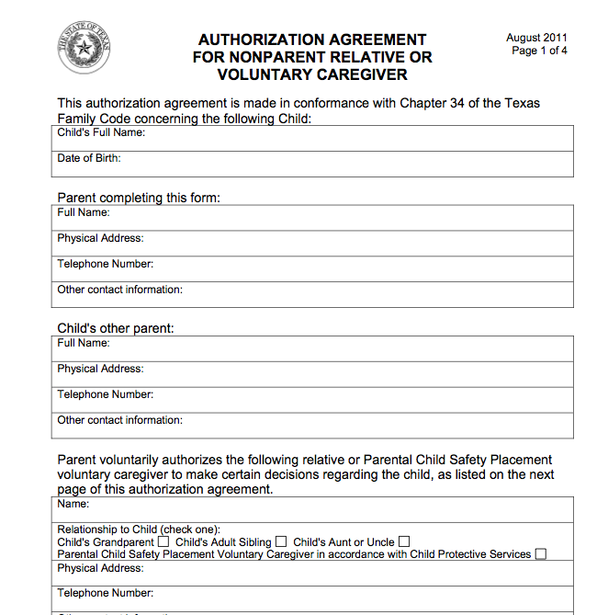
Make a plan for caregivers
Parents may be considering establishing a power of attorney for a designated caregiver for their children under the age of 18
Family law varies by state. Parents considering this option would be advised to connect with family law services through local legal aid organizations.
sample

Slide 32
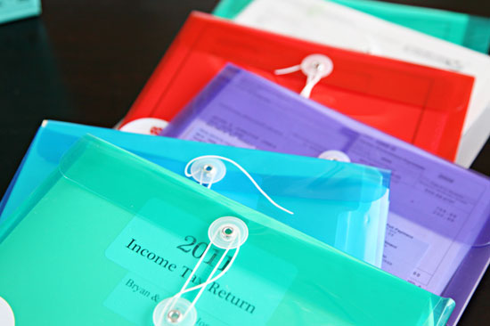
Have your documents ready and organized
Documents should be accesible by children, housemates or trusted relatives in case of an emergency
Passports
ID’s
Attorney contact information
Financial records
Letters from immigration
Alien registration number

Slide 33
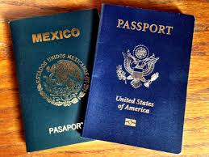

Collect important documents for children
Passports
Birth certificates
Social security cards
School and medical records

Slide 34


Organize your Financial information
Financial records
Bank Statements
Savings accounts
Credit cards
*Save money for legal fees/bonds

Slide 35
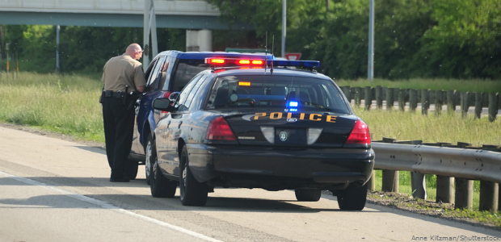
If stopped by the police
Be CALM!
Stop the car in a safe place as quickly as possible
Turn off the car
Turn on the internal light
Open the window part way
Place hands on the wheel

Slide 36

If stopped by the police
Don’t carry any false documents
Don’t lie. Tell the law enforcement agents you want to remain silent.
Don’t sign any document that you don’t understand
Don’t discuss your citizenship or immigration status with anyone other than your lawyer

Slide 37

Be cautious when driving
Don’t drink and drive
Make sure to have inspection and registration is up-to-date
Make sure all lights in your car work
Don’t hang any objects from your rearview mirror. It may provide a pretext for police to pull you over.

Slide 38
If you or a family is detained
Know the phone number of a person who can call a lawyer
Immediately inform officer
  If there are children or elderly family members at home
  If you have a medical condition
  If you need to coordinate care of children
Do not sign any documents given to you by immigration agents
Do report the raid or arrest immediately
Find an attorney and connect with local advocates

Slide 39
To find someone who has been detained by ICE
Use ICE’s online detainee locator to find an adult who is in immigration custody.
You can search by using the person’s Alien Registration Number and country of origin or biographical information: https://locator.ice.gov/odls/#/search
Call the local ICE field office: https://www.ice.gov/contact/ero
Call Executive Office for Immigration Review’s hotline at 304-625-2050 or 800-898-7180

Slide 40
Understanding Roles of Law Enforcement

Slide 41
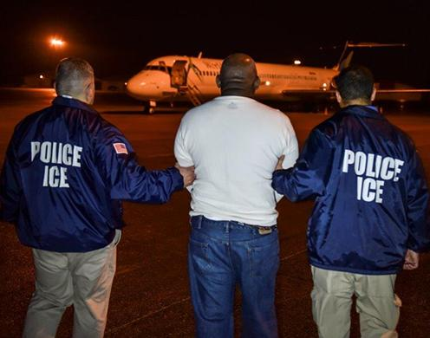
ICE Agents
Immigration and Customs Enforcement
Enforces federal laws
Governs border control,customs, trade and immigration
Focuses on Enforcement and Removal Operations and Homeland Security

Slide 42
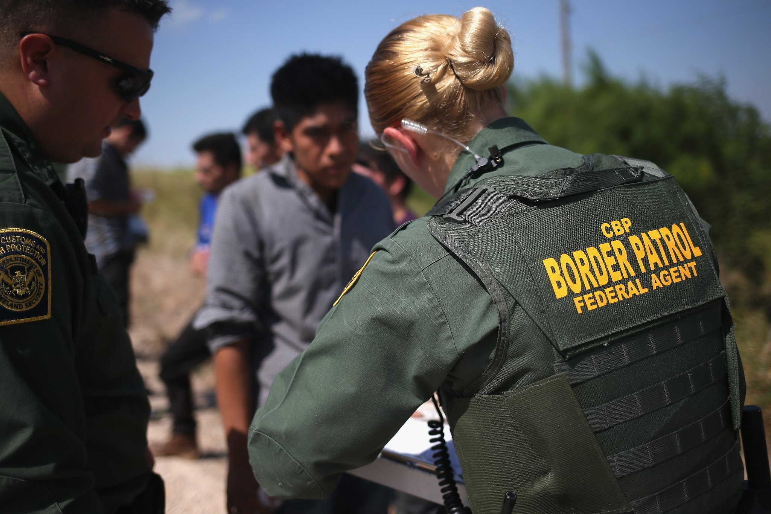
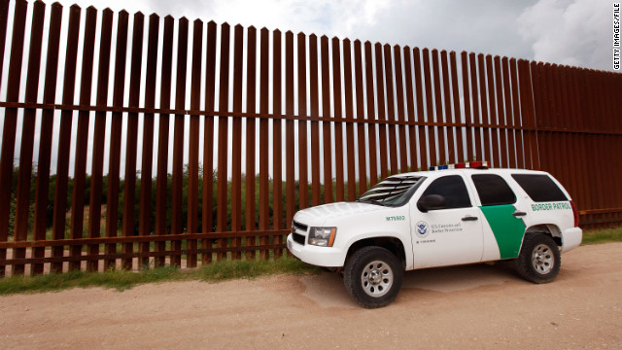
Border Patrol
Federal law enforcement agency
Prevent undocumented immigrants, terrorists and terrorist weapons from entering the U.S.
Prevent illegal trafficking of people and contraband

Slide 43
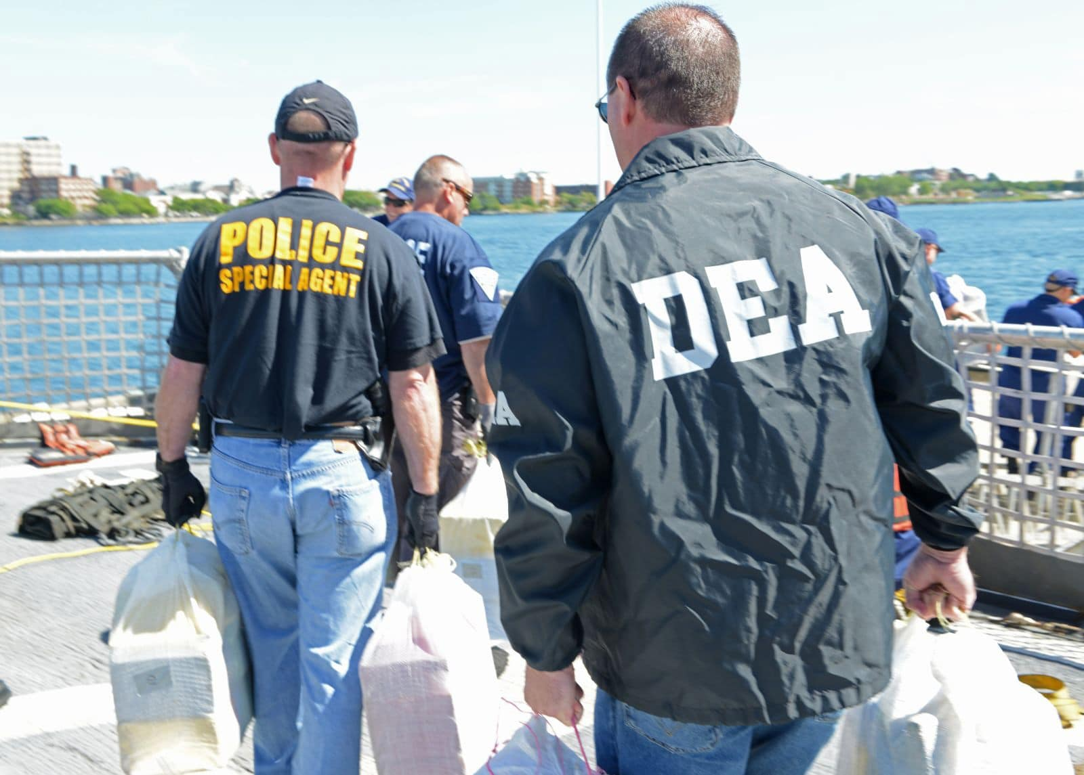
Other Federal Law Enforcement
U.S. Marshal Service
Drug Enforcement Agency (DEA)
Bureau of Alcohol, Tobacco, Firearms and Explosives (ATF)
Federal Bureau of Prisons (BOP)
As of January 2025, the Department of Homeland Security enabled the following agencies to investigate and apprehend undocumented immigrants:

Slide 44
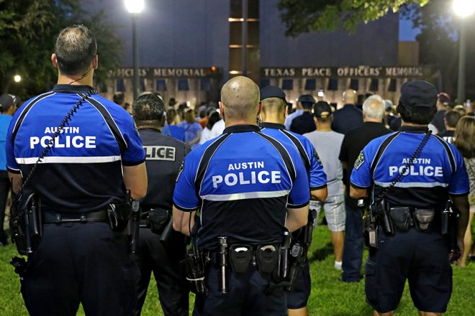
General Local Police Duties
Patrol communities
Enforce traffic and parking laws
Work with other police department units as well as other local, state and federal entities
Conduct preliminary investigations at crime scenes
Pursue, search and detain suspects
Make arrests
Respond to calls for service from the community
Please note: New Administration policies are giving local police departments greater immigration enforcement powers.

Slide 45
Over 750k Young People Hold Temporary Status That Benefits All Communities including students, educators & small business owners, etc.

Slide 46
About DACA
Deferred Action for Childhood Arrivals: What you need to know

Slide 47
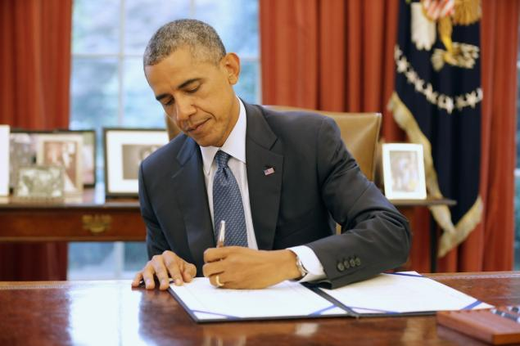

Deferred Action for Childhood Arrivals
( DACA )
Executive Action signed June 15, 2012, by President Obama that grants undocumented youth and young adults who meet certain criteria a work permit and temporary protection from deportation.
Subject to renewal
In most states DACA recipients can apply for a driver’s license
There have been several lawsuits around DACA. The most recent court decision came down in January 2025. At present, no new DACA applications are being processed. Recipients who are eligible for renewal should renew as soon as possible. DACA recipients are still protected from deportation.
Notes:
DACA requirements for applicants:
Were under the age of 31 as of June 15, 2012
Came to the U.S. before the age of 16
Have lived in the U.S. continuously since June 15, 2012
Entered without inspection before June 15, 2012
Were physically present in the U.S. on June 15, 2012
Are currently attending school, have a high school degree or GED
Have not been convicted of certain crimes
Pay application fee

Slide 48
Resources & Partners

Slide 49

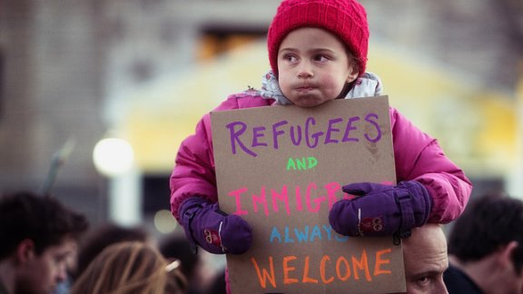
National Education Association (NEA)
NEA Guidance on Immigration Issues
Immigration Guidance (Higher Ed.)
Sample Safe Zone Res./Model Policy
How Educators Can Safely Engage in Immigration Advocacy
Sample Contract Language to Protect Immigrant Students
NEA Immigration Justice Site

Slide 50

United We Dream
United We Dream
Education Justice Resources
What to Know About the Latest DACA Decision
Conoce Tus Derechos

Slide 51

American Federation of Teachers (AFT)
AFT-Immigration/ Know Your Rights
Immigrant and Refugee Children-Guide for Educators (2017)
Teach Human Rights Lesson Plans
Share My Lesson: Immigration Lesson Plans and Resources
DACA -Guide for Educators and School Support Staff (2014)
Download Dreamer Poster

Slide 52

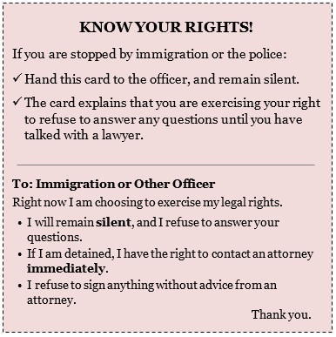
National Immigration Law Center
Education Providers and Immigration Enforcement
Protecting Immigrant Students & Employees – Higher Ed.
FAQ: Latest DACA Developments
Know Your Rights Fact Sheet (General) // Spanish Version
Education For All Campaign
Plyler and Data Collection (December 2024)

Slide 53



Mexican American Legal Defense Fund (MALDEF)
Know Your Rights (English & Spanish)
Plyler v. Doe 40th Anniversary (2022)
Immigrants’ Rights (available in many languages)
American Civil Liberties Union (ACLU)

Slide 54

Immigration Thematic Units
Colorin Colorado Classroom Resources on Immigration
Pancho Rabbit and the Coyote-Lesson Plans
Enrique’s Journey by Sonia Nazario- Lesson Plans
Which Way Home Film
Teach Human Rights Lesson Plans (AFT)
Share My Lesson: Immigration Lesson Plans and Resources (AFT)

Slide 55

Books about Immigration
30 Multicultural Picture Books about Immigration
Books about immigrant experience
Books to teach students about activism
First Book
Read Across America Books on Immigration

Slide 56
Other Resources
Colorin Colorado: Serving and Supporting Immigrant Students
Archived 2015 Dept. of Ed. Resource Guide: Supporting Undocumented Youth
DOJ directory of pro bono legal service providers
Teaching Tolerance
PBS Classroom Resources & Lessons on Immigration

Slide 57
A note from Education Austin, Vice President for Certified employees, Education Austin, Montserrat Garibay, NBCT (2016)
A special thank you to Immigration Lawyers: Faye Kolly, Sarah Woelk and Megan Sheffield.
Thank you NEA and AFT for supporting our social justice work.
And a special thank you to the educator and community activists who are working hard every day to ensure safe and welcoming schools where every student has the opportunity to learn.
Disclaimer
The material presented here should not be relied on as legal advice. Immigration matters are complex, depend on individual facts, and may necessitate assistance from an immigration lawyer. To find a low-cost or pro bono immigration attorney in your area, go to https://www.adminrelief.org/legalhelp/.

